Slide 1
Survey Analysis week 4 “Stratified and cluster sampling”
© Peter Lugtig

Slide 2
What have we done so far
Basics of survey error (TSE, bias, error)
Mean, variance, standard error, proportions
SRS sampling – with and without replacement
n-1
Fpc
R – survey and sampling packages
Sample size calculations for mean
For simple random sample
Given CV, margin of error, Confidence interval
Given alpha, Beta, population variance

Slide 3
What will we do today
Discuss THE week 3 in groups
Questions, issues?
Lecture on stratification and clustering
Stratification and clustering: why?
Variance estimation, design effects
2 short class exercises
Set up svydesign objects

Slide 4
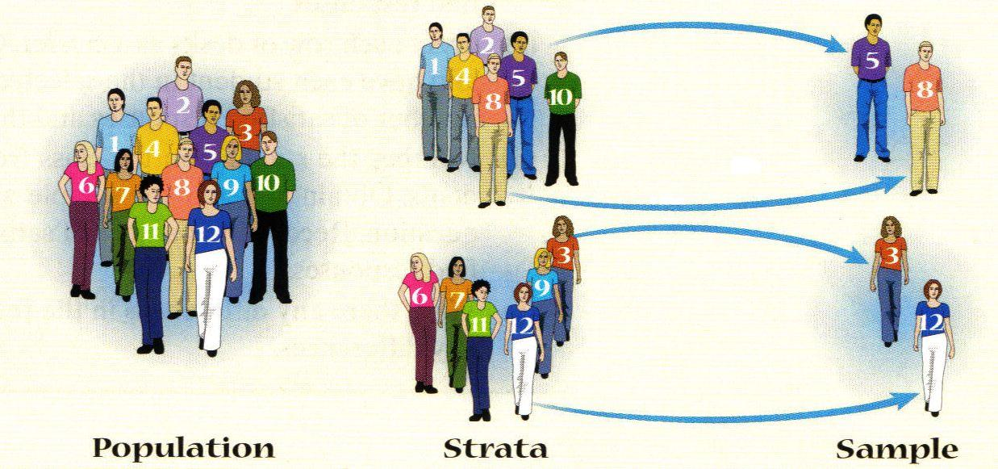
Stratified Random Sampling
Population exists of pre-defined groups
Use this information to optimize sampling design
Idea – take a SRS from each group (stratum) and combine these for the final sample

Slide 5
Stratified sample design – why?
A fictitious population of companies in Estonia
Sector/size (employees) | 1-4 | 5-49 | 50+
Manufacturing | 7000 | 1.800 | 335
Trade | 14.000 | 3.000 | 250
Business | 20.000 | 3.335 | 335
Government/education | 1.600 | 282 | 79
Healthcare | 1.100 | 625 | 224
Agriculture | 682 | 118 | 3

Slide 6
Stratified sample design – why?
Sector/size (employees) | 1-4 | 5-49 | 50+
Manufacturing | 7000 | 1.800 | 335
Trade | 14.000 | 3.000 | 250
Business | 20.000 | 3.335 | 335
Government/education | 1.600 | 282 | 79
Healthcare | 1.100 | 625 | 224
Agriculture | 682 | 118 | 3
1. Increase precision in total (< s.e.)
2. Ensure precision in subgroups
3. More practical when sampling frames are only available per subgroup
4. + to limit other surveys errors (later)

Slide 7
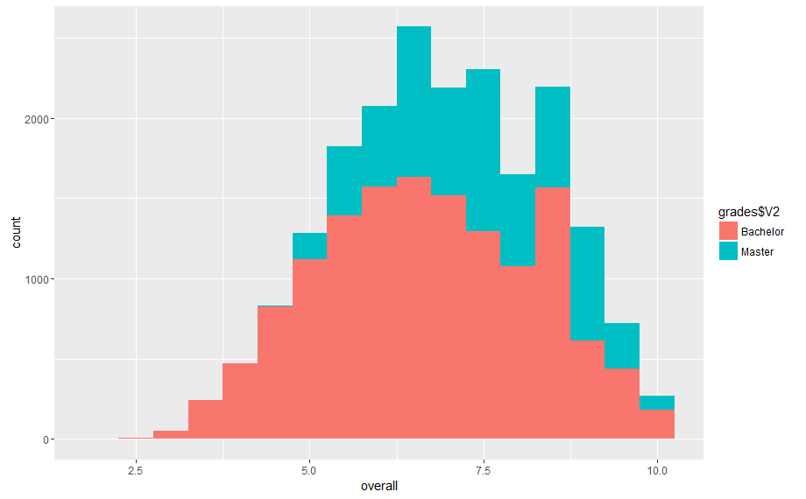
An example: population of student grades at UU
Total: 20000 students
14000 BA, 6000 MA
Now, what if we want to sample?
Last week: simple random sample
Size = 1000
R-Code of example on BlackBoard

Slide 8
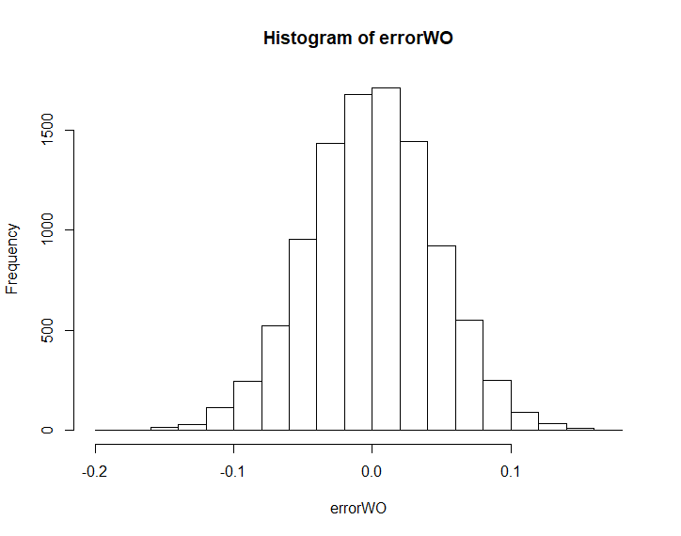
Simple Random sample
Draw 10000 samples (replications)
Each, n=1000

Slide 9
Simple Random sample
Size=1000 out of 20000
Draw 10000 samples (replications)
Roughly 700 BA students, 300 Ma students
MSE = -.026² + .0021 = .0027
How can we improve?
 | Bias | Variance (s.e)
Simple random sample | -.026 | .0021

Slide 10
Back to example: population of student grades at UU
Total: 20000 students
14000 BA, 6000 MA
Why stratify on degree?
Mean BA: 6.69
Mean MA: 7.41
Var(BA):2.36
Var(MA): 1.49
Var(total): 2.20
R-Code of example on BlackBoard

Slide 11
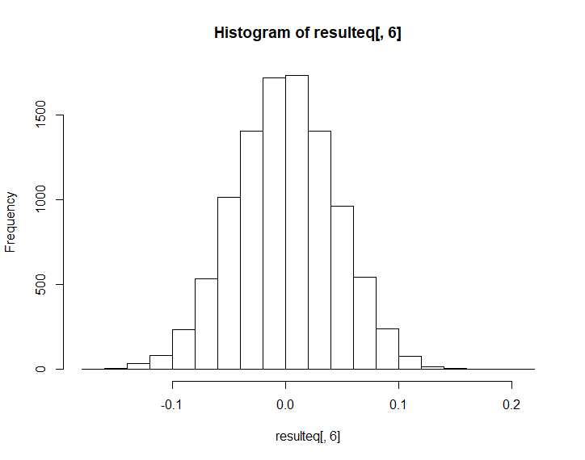
Stratification with equal probabilities
Size=1000, 10000 replications
Exactly 700 BA students, 300 Ma students
Proportional to Size (PPS)
Error compared to population mean

Slide 12
Comparison of standard errors
SRS Stratification pps
Slightly fewer extreme samples: stratification reduces s.e.

Slide 13
Stratification with equal probabilities
Size=10000
Exactly 700 BA students, 300 Ma students
Proportional to Size (PPS)
 | Bias | Var(mean) | Var(mean) Bachelor | Var(mean) Master
Simple random sample | -,026 | ,0021
Stratification equal probabilities | -,031 | ,001966 | ,0031 | ,0047

Slide 14
Design effect
If we have a measure of the bias in standard (SRS) estimates of the sampling variance this can be used to adjust the variances or standard errors from SRS
D_{eff} = Variance under specific design
Variance under SRS
D_{eff}= inflation factor for variance
Can be used for estimating effective sample size
n_{eff} = N/D_{eff}
D_{eft} = √_{Deff} = inflation for standard error

Slide 15
Design effect (2)
D_{eft} = .00197/.0021 = .9523
D_{eff} = .952^{2.} We need .906 as many respondents for same precision
N_{eff} = 1000/.906 = 1103
Stratified sample: D_{eff} <1
Cluster sample: D_{eff} >1
R produces Design effect as well
For one sample against same sample under SRS
(Pooled) d_{eft} in R: .951
Rounding error in manual computation above

Slide 16
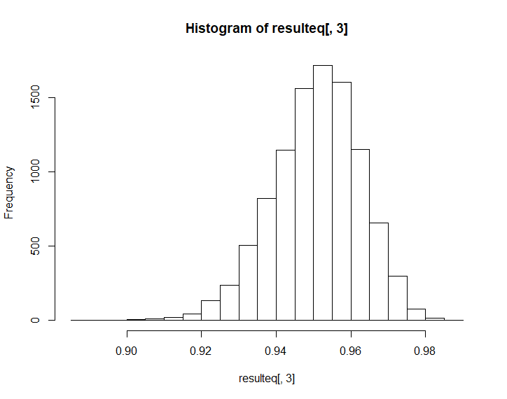
Design effect (3)
R produces Design effect as well
10000 estimates of design effect
Note this is skewed (why?)

Slide 17

Formulas
1. Mean with SRS in every stratum
$\overline{yh}$ = $\frac{1}{nh}\sum{yhj}$
2. Combining means :
$\overline{y}$_{str} = $\sum{\frac{Nh}{N}\overline{y}h}$
Size of stratum in population

Slide 18
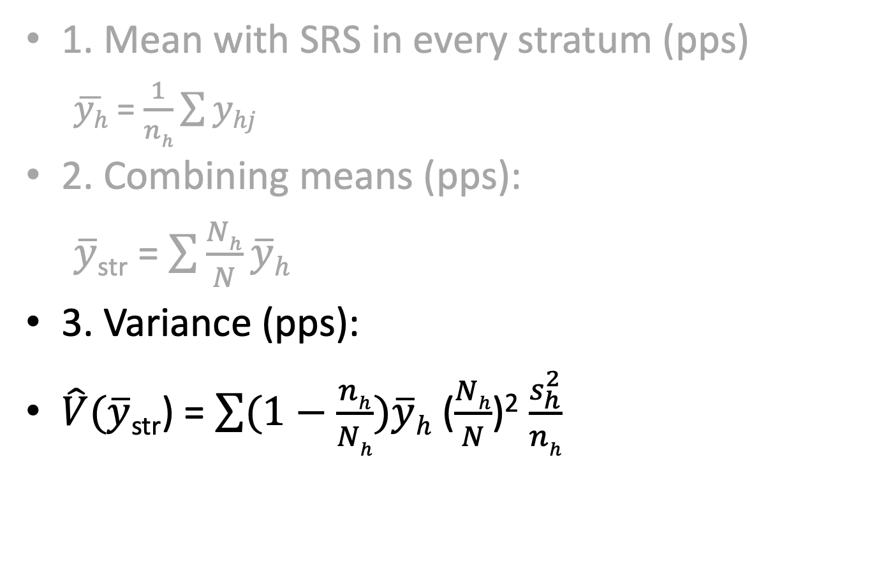
Formulas
1. Mean with SRS in every stratum (pps)
$\overline{yh}$ = $\frac{1}{nh}\sum{yhj}$
2. Combining means (pps):
$\overline{y}$_{str} = $\sum{\frac{Nh}{N}\overline{y}h}$
3. Variance (pps):
$\hat{V}(\overline{y}\text{str}$) = $\sum{(1−\frac{nh}{Nh})\overline{y}h}$ ($\frac{Nh}{N}$)² $\frac{s_{h}^{2}}{nh}$
Variance in stratum
Fpc per stratum
(Size of stratum in population)²

Slide 19
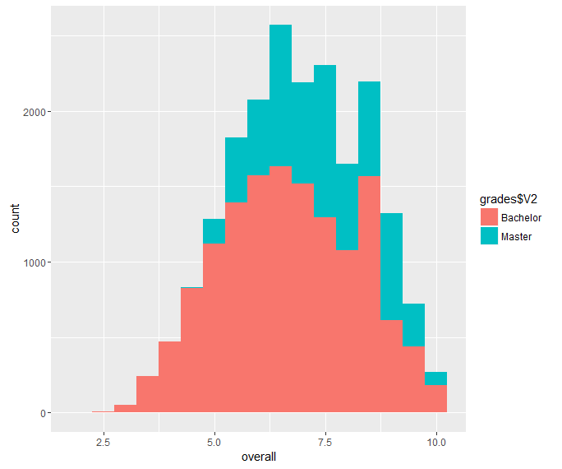
Unequal probabilities
Why?
Increase precision for small group in population (Ma students
Optimize the precision for the total mean grade?

Slide 20
Unequal probabilities
Population: 14000 BA, 6000 MA
We can oversample MA students
Because there is more nonresponse, or we want increased precision in this group
Imagine we sample 500 students from each group
π(BA) = 500/14000 = .035714
π(MA) = 500/6000 = .083333

Slide 21
Stratification with unequal probabilities
Size=1000
500 BA students, 500 Ma students
#$%&: wasn’t stratified sampling supposed to decrease the variance?
 | Bias | Var(mean) | Var(mean) Bachelor | Var(mean) Master
Simple random sample | -,026 | ,0021
Stratification PPS | -,031 | ,001966 | ,0031 | ,0047
500 in each | ,023 | ,0025 | ,0047 | ,0027

Slide 22
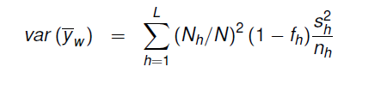
Back to the example: student grades at UU
Variance stratified sampling (PPS):
With unequal sampling:
need for including weights:
700/500 = 1.4 for BA students
300/500 = 0.6 for MA students
S²:

Slide 23
Unequal probabilities
Population: 14000 BA, 6000 MA
Imagine we sample 500 students from each group
π(BA) = 500/14000 = .03571
π(MA) = 500/6000 = .0833
Need to use weights if we want to say about the total
Wt(BA) = 1/.03571 = 28
Wt(MA) = 1/.08333 = 12
Or scaled weights
Ws(BA) = 28/20 = 1.40
Ws(MA) = 12/20 = 0.60
Ws: scaled weights, Wt: total weights
So, how can we optimize sample size across strata?

Slide 24
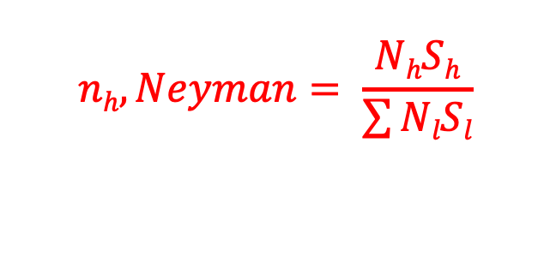
Optimal allocation
How large should samples within strata be so that s.e. for population is minimized?
Neyman allocation:
N_{h} = sample size stratum
S_{h} = standard deviation in stratum
Needed?
N_{l} = Population size
S_{l} = Standard deviation in population (!)
Often costs are included (more complicated)
$$nh, Neyman= \frac{NhSh}{\sum{NlSl}}$$

Slide 25
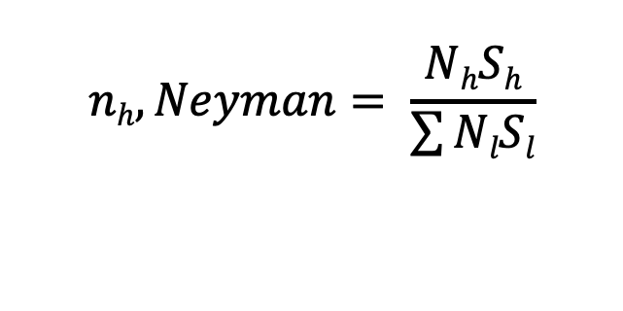
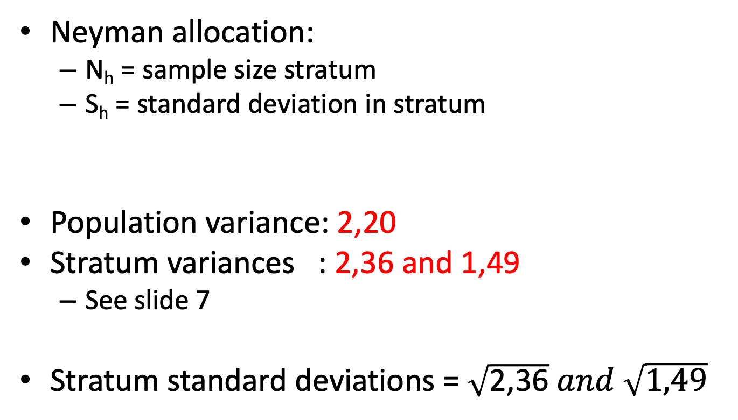
Optimal allocation: example
$$nh, Neyman= \frac{NhSh}{\sum{NlSl}}$$
Neyman allocation:
N_{h} = sample size stratum
S_{h} = standard deviation in stratum
Population variance: 2,20
Stratum variances : 2,36 and 1,49
See slide 7
Stratum standard deviations = $\sqrt{\text{2,36}} and \sqrt{\text{1,49}}$

Slide 26
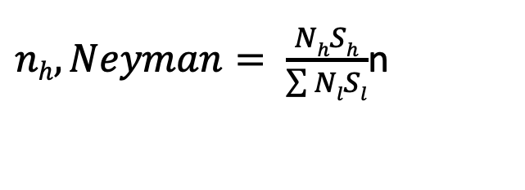
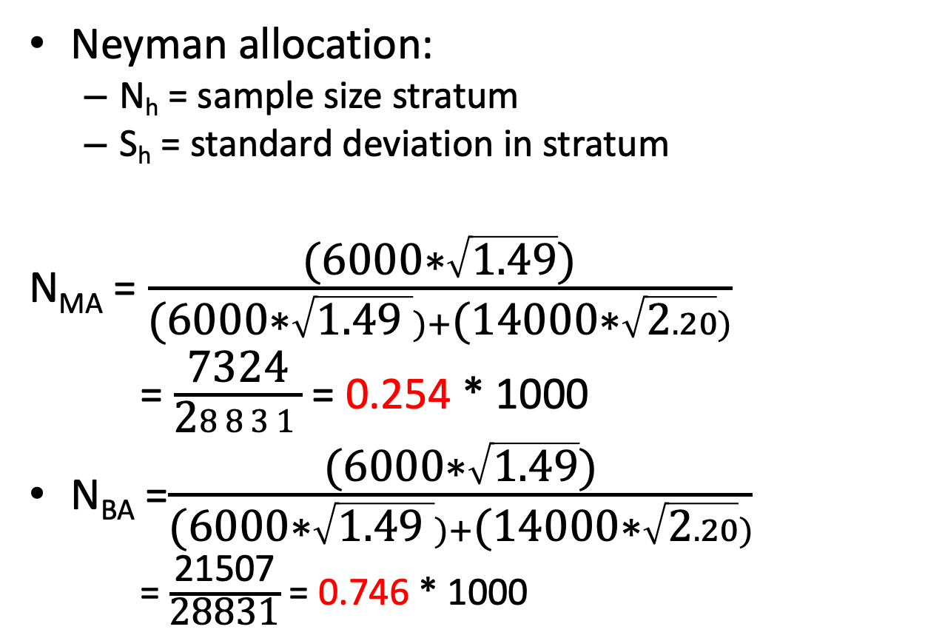
Optimal allocation: example
Neyman allocation:
N_{h} = sample size stratum
S_{h} = standard deviation in stratum
N_{MA} = $\frac{\text{(6000∗}\sqrt{\text{1.49}}\text{)}}{\text{(6000∗}\sqrt{\text{1.4}\text{9 }})+\text{(}\text{14}\text{000∗}\sqrt{\text{2}.20})}$
= $\frac{\text{7324}}{\text{2}8831}$ = 0.254 * 1000
N_{BA} =$\frac{\text{(6000∗}\sqrt{\text{1.49}}\text{)}}{\text{(6000∗}\sqrt{\text{1.49 }})+\text{(}\text{14}\text{000∗}\sqrt{\text{2}.20})}$
= $\frac{\text{21507}}{\text{2}\text{8831}}$ = 0.746 * 1000
$nh, Neyman= \frac{NhSh}{\sum{NlSl}}$n

Slide 27
Optimal allocation to strata
Size=1000
746 BA students, 254 Ma students
 | Bias | Var(mean) | Var(mean) Bachelor | Var(mean) Master
Simple random sample | -,026 | ,0021
Stratification equal probabilities | -,031 | ,001966 | ,0031 | ,0047
500 in each | ,023 | ,0025 | ,0047 | ,0027
Neyman | ,04 | ,001962 | ,0029 | ,0055

Slide 28
Optimal allocation to strata
Unequal selection probabilities
746 BA students, 254 Ma students
D_{eft} = .01962/ .0021 = .934
n_{eff}= 1000/.93²= 1145
In words: we optimize stratification when:
The stratum accounts for a large part of the population
BA = 0.7, MA= 0.3
The variance within the stratum is large; we sample more heavily to compensate
variance BA:2.36, Variance MA: 1.49
-> leads to 746 BA students

Slide 29
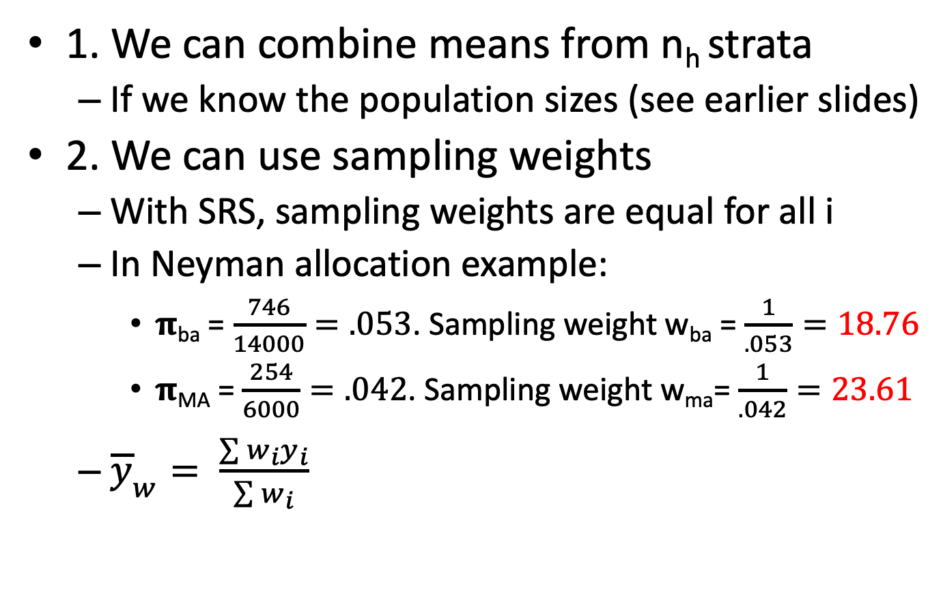
2 ways to deal with unequal selection
1. We can combine means from n_{h} strata
If we know the population sizes (see earlier slides)
2. We can use sampling weights
With SRS, sampling weights are equal for all i
In Neyman allocation example:
𝛑_{ba} = $\frac{746}{14000}=.053$. Sampling weight w_{ba} = $\frac{1}{.053}=18.76$
𝛑_{MA} = $\frac{254}{6000}=.042$. Sampling weight w_{ma}= $\frac{1}{.042}=23.61$
${\overline{y}}_{w}= \frac{\sum{w_{i}y_{i}}}{\sum{w_{i}}}$

Slide 30
Bringing Nonresponse in (more in week 8-10)
We often oversample from specific groups
Nonresponse
Imagine:
Response rate of 50% among BA students
And 20% among Ma students
Achieved sample = 399 BA , 40 MA students
We can correct by using Nonresponse weights, but this is inefficient

Slide 31
Should we actually stratify on Ba/MA?
What variable to stratify on?
BA/MA, Faculties, Programme
Social science, humanities, etc.
Gender, Age, living in Utrecht
Member of student union
Etc.
We can stratify on multiple variables
Survey mode:
E-mail: stratification easy
Face-to-face: costs!
Cluster sampling?

Slide 32
Class exercise 1
Draw and analyse a stratified sample from a simplified dataset
Understand the basic R code for specifying stratified survey design object
Which variable to stratify on?
See Class exercise document (Blackboard)

Slide 33
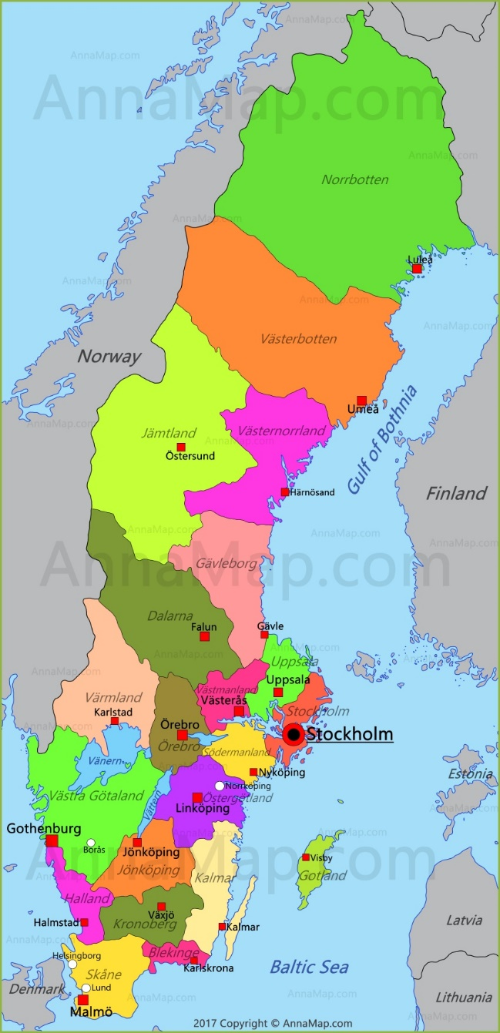
Adding in clusters
What if we don’t use e-mail?
Cost per case: € 0,50
But face-to-face
Costs per programme: € 50,-
Costs per case: €10,-
Households, businesses
Hospitals, schools
Towns!

Slide 34
Terminology
Primary sampling units (psu)
Clusters
Secondary sampling units (ssu)
Intra-Cluster(Class) Correlation Coefficient (ICC)
One-stage sample: whole cluster interviewed
Two-stage sample: further sampling within clusters
Ratio estimation (week 7)

Slide 35
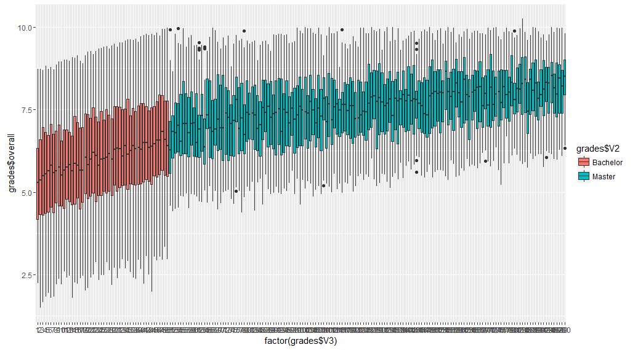
Example – 150 programmes (Ba/MA) simulated data
Student grades (y)
200 programmes (x)
50 BA, n=280 each
150 MA, n=40 each
Population mean: 6.52
R-code is available on Blackboard

Slide 36
Cluster sampling – why and how
How?
One-stage: ask everyone in cluster
Educational surveys: ask every pupil at school (or class)
Two stage: do a sample within every cluster
Multi-stage: e.g.
1. stratify on income in neighboorhood
2. neighbourhoods (PSU)
3. households (SSU)
4. individual in hh

Slide 37
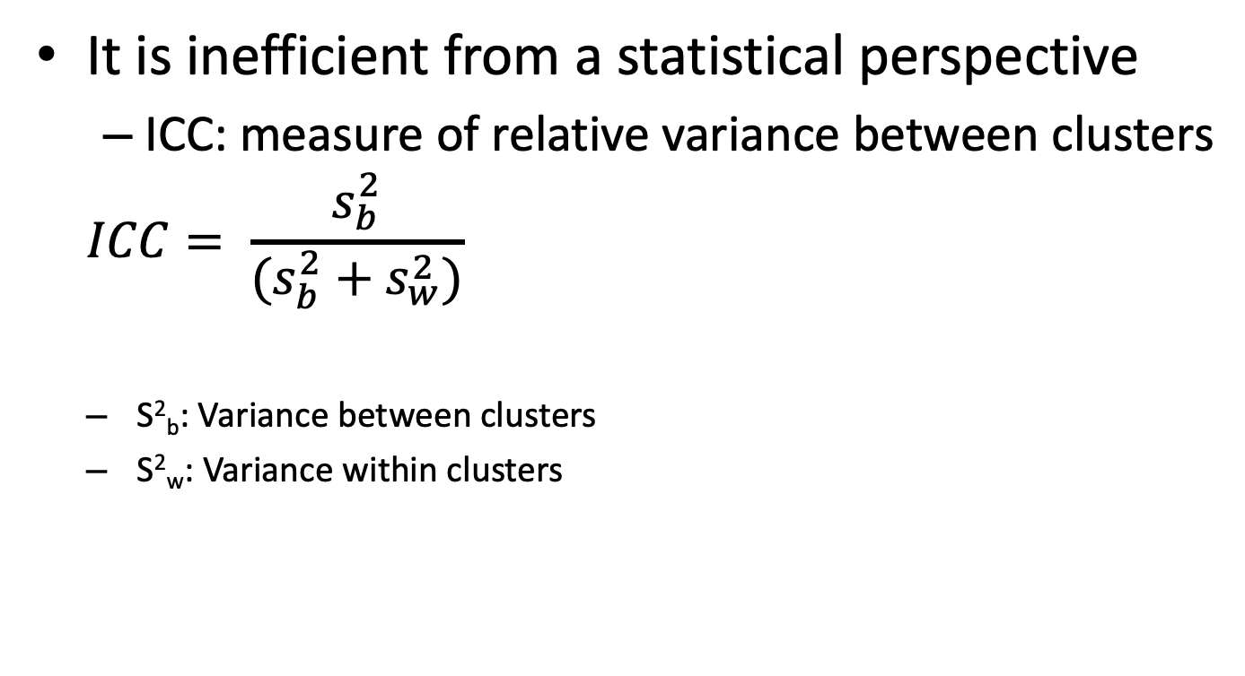
Why not do a cluster sample
It is inefficient from a statistical perspective
ICC: measure of relative variance between clusters
$$ICC= \frac{s_{b}^{2}}{(s_{b}^{2}+s_{w}^{2})}$$
S²_{b}: Variance between clusters
S²_{w}: Variance within clusters

Slide 38
One-stage cluster sampling
Clusters of equal size:
Selection probabilities equal for all i -> SRS of clusters
Rarely the case
Clusters of unequal size:
1. draw clusters with unequal selection probabilities
Proportional to Size (PPS)
Self-adjusting sample
2. Or, draw SRS of clusters
Use weights to correct for unequal probabilities
Example: draw 7 clusters out of 150 with SRS
Average cluster size = 133, expected sample size = 933

Slide 39
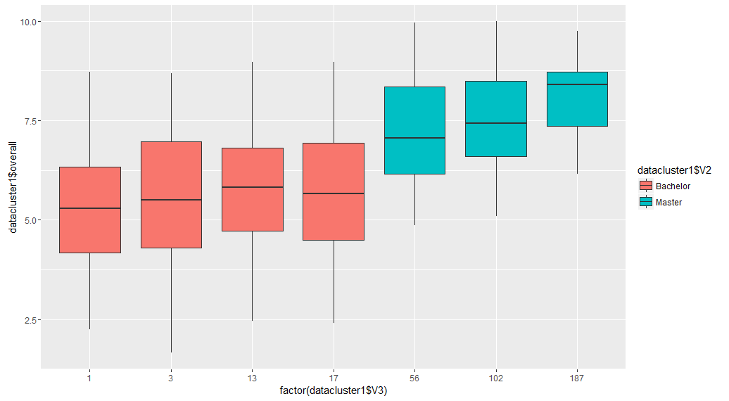
1 draw for One-stage cluster sample
Results from R (1 sample)
n=1240
mean: 5.79 (!) (population = 6.52)
s.e. SRS .045624
s.e. cluster .17397
D_{eft}= .17397 /.045624 = 3.81
Why are results so bad?

Slide 40
Problems in 1-stage cluster sampling
In our example:
Bad luck: Clusters selected:
1,3,13,39,56,102,187
Small no. of clusters sampled
Large difference between cluster means (large ICC)
ICC population:
For Ba/MA: .18
For Programme: .21
In general:
hard to control sample size
Design effect could be large if variance differs across clusters

Slide 41
Were we unlucky? a simulation
10000 replications
10 clusters
n=1000 on average
but large variation
Bias
,0005 on average
Long tail
when we sample only MA or BA

Slide 42
a simulation for 1-stage cluster (2)
10000 replications
10 clusters
n=1000 on average
but large variation
Design effect (D_{eff}):
23 (!) on average
We would need sample of 23.000!

Slide 43
Better: A 2-stage cluster sample
Double the clusters, sample half
1. Sample 20 clusters (instead of 10) using SRS
2. Sample ½ of i within every cluster > expected sample size= 1000
Or do 50 clusters and sample ¹/₅ of individuals, etc.
Optimal allocation given ICC and costs
But need good estimates for:
Costs?
population total? , cluster sizes? (~fpc),
Often: use of “pseudoclusters”

Slide 44
Two-stage cluster simulation
10000 replications
20/50 clusters
Second stage sample ½ or ¹/₅
n=1000 on average (but less variation)
Bias
20 clusters: -.0034
50 clusters: -.0322

Slide 45
Two-stage cluster simulation
10000 replications
20/50 clusters
Second stage sample ½ or ¹/₅
n=1000 on average (but less variation)
Design effect (deft)
20 clusters: 16
50 clusters: 6.8

Slide 46
Two-stage cluster estimation
Uncertainty now at 2 levels
Sampling of clusters
Sampling of individuals in clusters
Ok for Means, regression coefficients
Imagine we do SRS for selection of clusters and individuals
Complex for variances
Rely on R for variance estimation

Slide 47
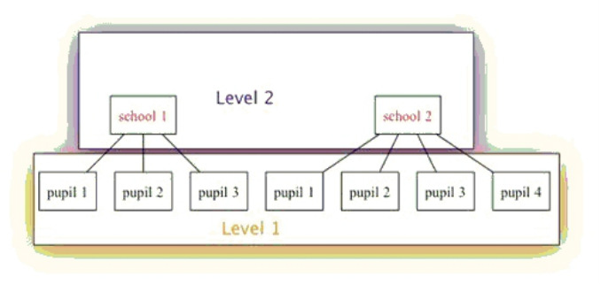
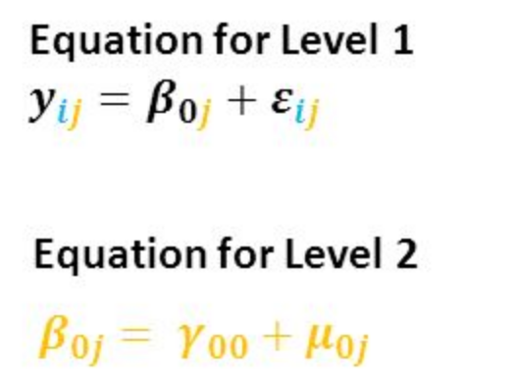
Analysis of cluster samples
Use the survey package
Do multilevel analysis (in semester 2)
Economists use Huber-White “robust” standard errors
Pretend your dataset is SRS,
estimate d_{eft} and
multiply your s.e. with deft

Slide 48
What about other parameters than mean?
In complex samples mean estimation ok
For other statistics:
Linearisation (Taylor expansion)
Sample reuse or replication
(balanced half-samples, jackknife, bootstrap)
Adjusting the traditional (SRS) estimates
All available in survey package!
Next week exercises

Slide 49
Class exercise 2
Analyse a cluster sample for the “boys” dataset
See Class exercise document (Blackboard)
If unfinished, finish at home before practical next week

Slide 50
Next week:
Finish: Class exercises – different sampling designs
discussion about problems in class next week.
Take Home Exercise:
Obtain the data: you often need to register at the data archive
Next week: practical (in class time)
Mix SRS, stratified and cluster sampling
Design weights
Hurvitz-Thompson estimator
Multistage sampling
…

